Slide 1
NumPy
G. Sathvik

Slide 2
Table Of Contents
Introduction
Why use NumPy ?
NumPy Arrays Creation
Types of Arrays
217 NumPy Functionalities
Understanding Functionalities
Conclusion

Slide 3

Introduction
NumPy is a library in the Python ecosystem for numerical computing and scientific computing.
NumPy stands for “Numerical Python”.
NumPy was created in 2005 by Travis Oliphant. It is an open source project and you can use it freely.

Slide 4
Why use NumPy ?
In python we have list to serve purpose of python but NumPy's array operations are faster than regular Python code.
It offers a wide range of mathematical functions for computations.
It provides efficient storage and manipulation of large datasets.
Memory efficiency ensures optimal usage of system resources.
It provides efficient storage and manipulation of large datasets.

Slide 5
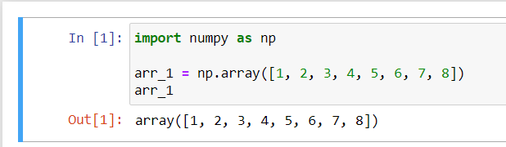
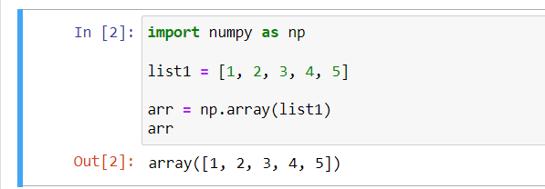
NumPy Arrays Creation
Creating a new array
Convert an array from list

Slide 6
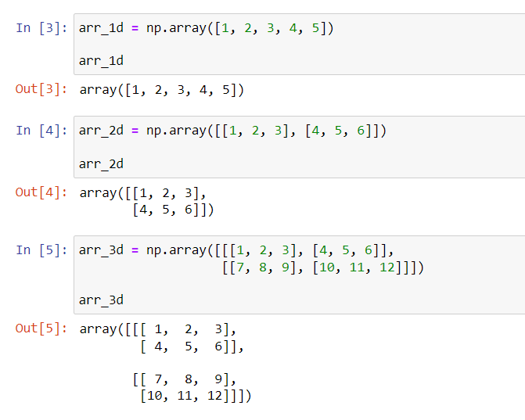
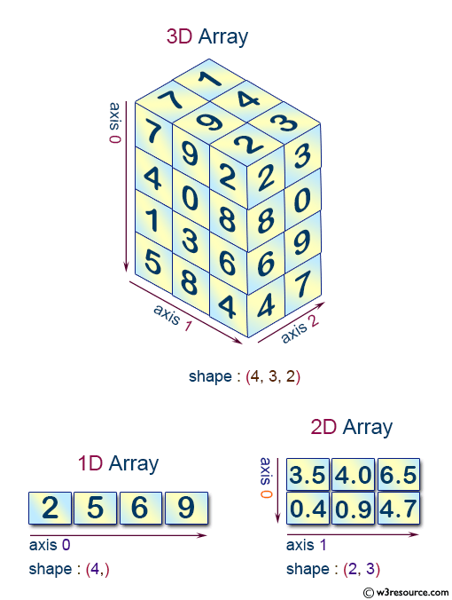
Types of Arrays
1D – Array
2D – Array
3D – Array

Slide 7
NumPy Functionalities
...
[]
abs()
absolute()
accumulate()
add()
all()
allclose()
alltrue()
angle()
any()
append()
apply_along_axis()
apply_over_axes()
arange()
arccos()
arccosh()
arcsin()
arcsinh()
arctan()
arctan2()
arctanh()
argmax()
argmin()
argsort()
array()
arrayrange()
array_split()
asarray()
asanyarray()
asmatrix()
astype()
atleast_1d()
atleast_2d()
atleast_3d()
average()
beta()
binary_repr()
bincount()
binomial()

Slide 8
NumPy Functionalities
bitwise_and()
bitwise_or()
bitwise_xor()
bmat()
broadcast()
bytes()
c_[]
cast[]()
ceil()
choose()
clip()
column_stack()
compress()
concatenate()
conj()
conjugate()
copy()
corrcoef()
cos()
cov()
cross()
cumprod()
cumsum()
delete()
det()
diag()
diagflat()
diagonal()
diff()
digitize()
dot()
dsplit()
dstack()
dtype()
empty()
empty_like()
expand_dims()
eye()
fft()
fftfreq()

Slide 9
NumPy Functionalities
fftshift()
fill()
finfo()
fix()
flat
flatten()
fliplr()
flipud()
floor()
fromarrays()
frombuffer()
fromfile()
fromfunction()
fromiter()
generic
gumbel()
histogram()
hsplit()
hstack()
hypot()
identity()
ifft()
imag
index_exp[]
indices()
inf
inner()
insert()
inv()
iscomplex()
iscomplexobj()
item()
ix_()
lexsort()
linspace()
loadtxt()
logical_and()
logical_not()
logical_or()
logical_xor()

Slide 10
NumPy Functionalities
logspace()
lstsq()
mat()
matrix()
max()
maximum()
mean()
median()
mgrid[]
min()
minimum()
multiply()
nan
ndenumerate()
ndim
ndindex()
newaxis
nonzero()
ogrid()
ones()
ones_like()
outer()
permutation()
piecewise()
pinv()
poisson()
poly1d()
polyfit()
prod()
ptp()
put()
putmask()
r_[]
rand()
randint()
randn()
random_integers()
random_sample()
ranf()
ravel()

Slide 11
NumPy Functionalities
real
recarray()
reduce()
repeat()
reshape()
resize()
rollaxis()
round()
rot90()
s_[]
sample()
savetxt()
searchsorted()
seed()
select()
set_printoptions()
shape
shuffle()
slice()
solve()
sometrue()
sort()
split()
squeeze()
std()
standard_normal()
sum()
svd()
swapaxes()
T
take()
tensordot()
tile()
tofile()
tolist()
trace()
transpose()
tri()
tril()
trim_zeros()

Slide 12
NumPy Functionalities
triu()
typeDict()
uniform()
unique()
unique1d()
vander()
var()
vdot()
vectorize()
view()
vonmises()
vsplit()
vstack()
weibull()
where()
zeros()
zeros_like()

Slide 13
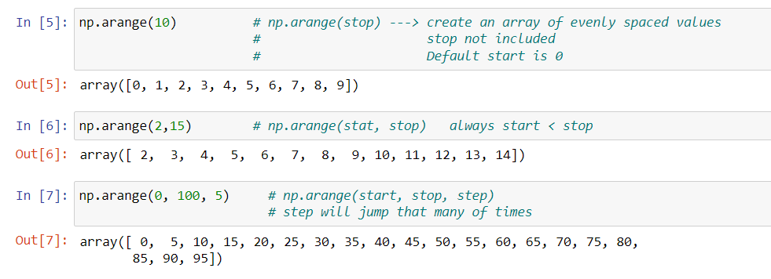
Understanding Functionalities
arrange( )

Slide 14
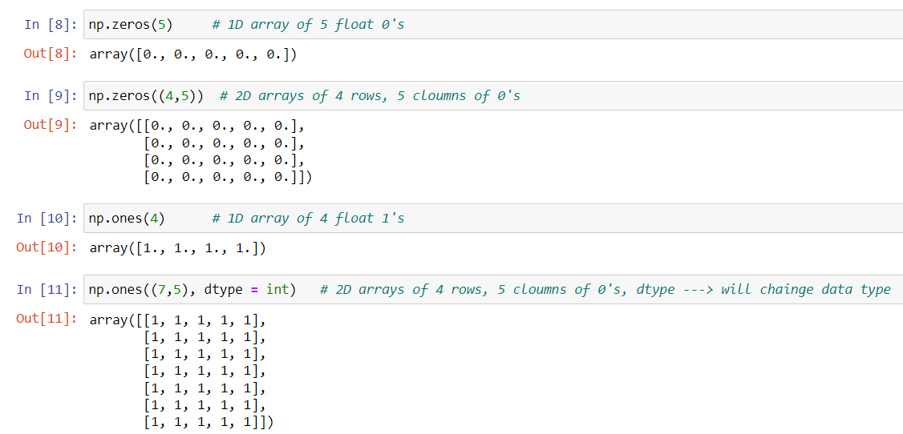
Understanding Functionalities
zeros( ) & ones( )

Slide 15
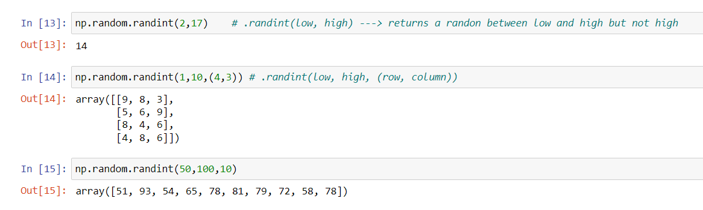
Understanding Functionalities
random.randint( )

Slide 16
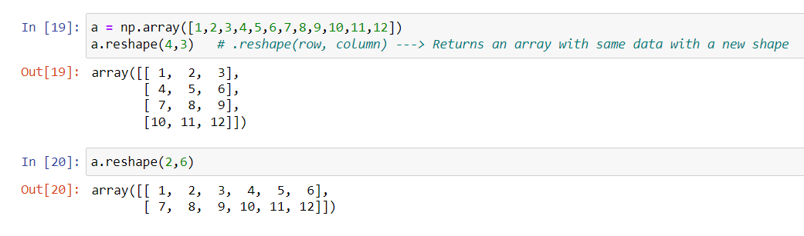
Understanding Functionalities
reshape( )

Slide 17
Conclusion
In this presentation we have learned about importance of numpy and why we should use it. How arrays are faster than lists and types of arrays.
All the names of 217 numpy functionalities and understood few of them.

Slide 18
Thank You
Author: G. SATHVIK
sathvikganta10@gmail.com
https://github.com/SathvikGanta10

